Slide 1
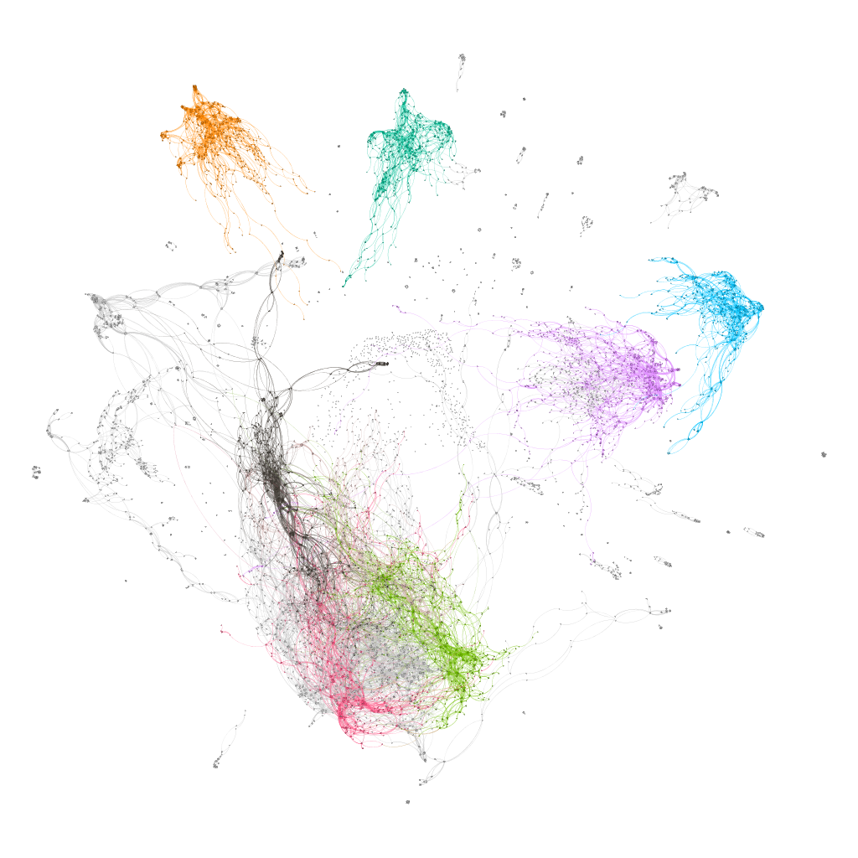
Topology of networks in generalized musical spaces
Marco Buongiorno Nardelli
CEMI – Center for experimental Music and Intermedia
iARTA – Initiative for Advanced Research in Technology and the Arts
Department of Physics
University of North Texas

Slide 2

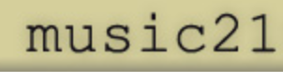
pcsPy: a python utility for generalized pitch class set classification, analysis and composition
The PCSet class:
pcs operations generalized to arbitrary temperament:
Transpose
Inverse
Normal order
Prime form
Interval vector
LISV vector
pcs classification
…etc.
Network and graph analysis functions:
Dictionary of pcs with arbitrary cardinality
Network construction with user-defined metric (distance)
Interval vector networks
Voice leading networks
ego-networks
… etc.

Slide 3
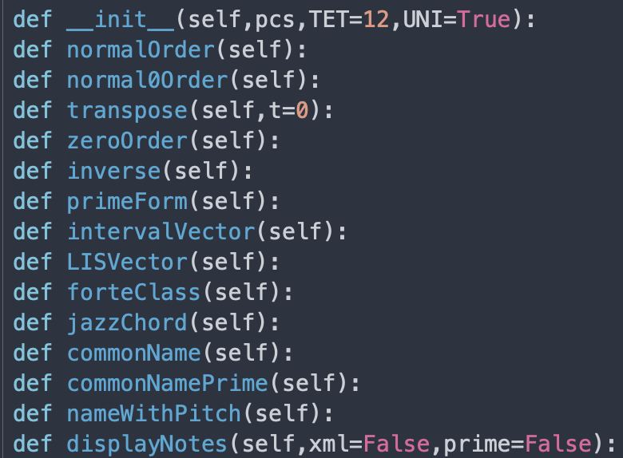
pcsPy: a python utility for generalized pitch class set classification, analysis and composition
The PCSet class:

Slide 4
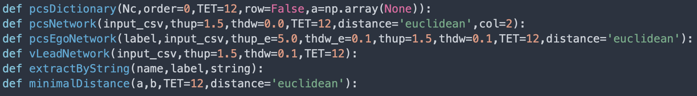
pcsPy: a python utility for generalized pitch class set classification, analysis and composition
Network and graph analysis functions:
Distance as metric in the musical space
Euclidean distance: ordinary straight line distance between two points in the chosen musical space (Pythagoras theorem)
interval vector (IV) distance: IVs are naturally ordered and their distance can be calculated directly
voice leading distance: minimal distance between pcs of same cardinality
Two different representations of the musical space!

Slide 5
Dictionaries
Generalized dictionary of pcs for arbitrary temperament – universal classification

Slide 6
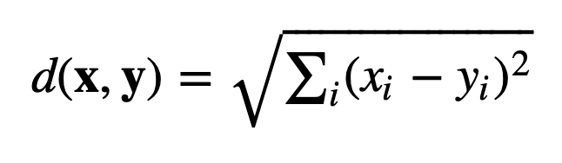
Topology in the interval vector space
operator | distance | weight
O(1) | 1.0000 | 1.0000
O(1,1) | 1.4142 | 0.7071
O(1,1,1) | 1.7321 | 0.5774
O(2) | 2.0000 | 0.5000
O(1,1,1,1) | 2.0000 | 0.5000
O(1,2) | 2.2361 | 0.4472
O(1,1,1,1,1) | 2.2361 | 0.4472
O(2,1,1) | 2.4494 | 0.4083
O(1,1,1,1,1,1) | 2.4495 | 0.4082
O(2,1,1,1) | 2.6457 | 0.3780
O(2,1,1,1,1) | 2.8284 | 0.3536
O(2,2) | 2.8284 | 0.3536
O(2,1,1,1,1,1) | 3.0000 | 0.3333
O(2,2,1) | 3.0000 | 0.3333
O(3) | 3.0000 | 0.3333
O(1,3) | 3.1622 | 0.3162
O(2,1,1,1) | 3.1622 | 0.3162
O(1,1,3) | 3.3166 | 0.3015
O(1,1,1,2) | 3.4641 | 0.2887
O(2,3) | 3.6056 | 0.2774
O(1,2,3) | 3.7416 | 0.2673
O(4) | 4.0000 | 0.2500
More on distances:
Weight = 1/distance
Operator: how many elements are changed by n integers O(1,1,2) = two elements are raised or lowered by 1, one is raised or lowered by 2 – all permutations possible
Operators must have dimensions ≤ dim(IntervalVector) ≡ TET/2

Slide 7
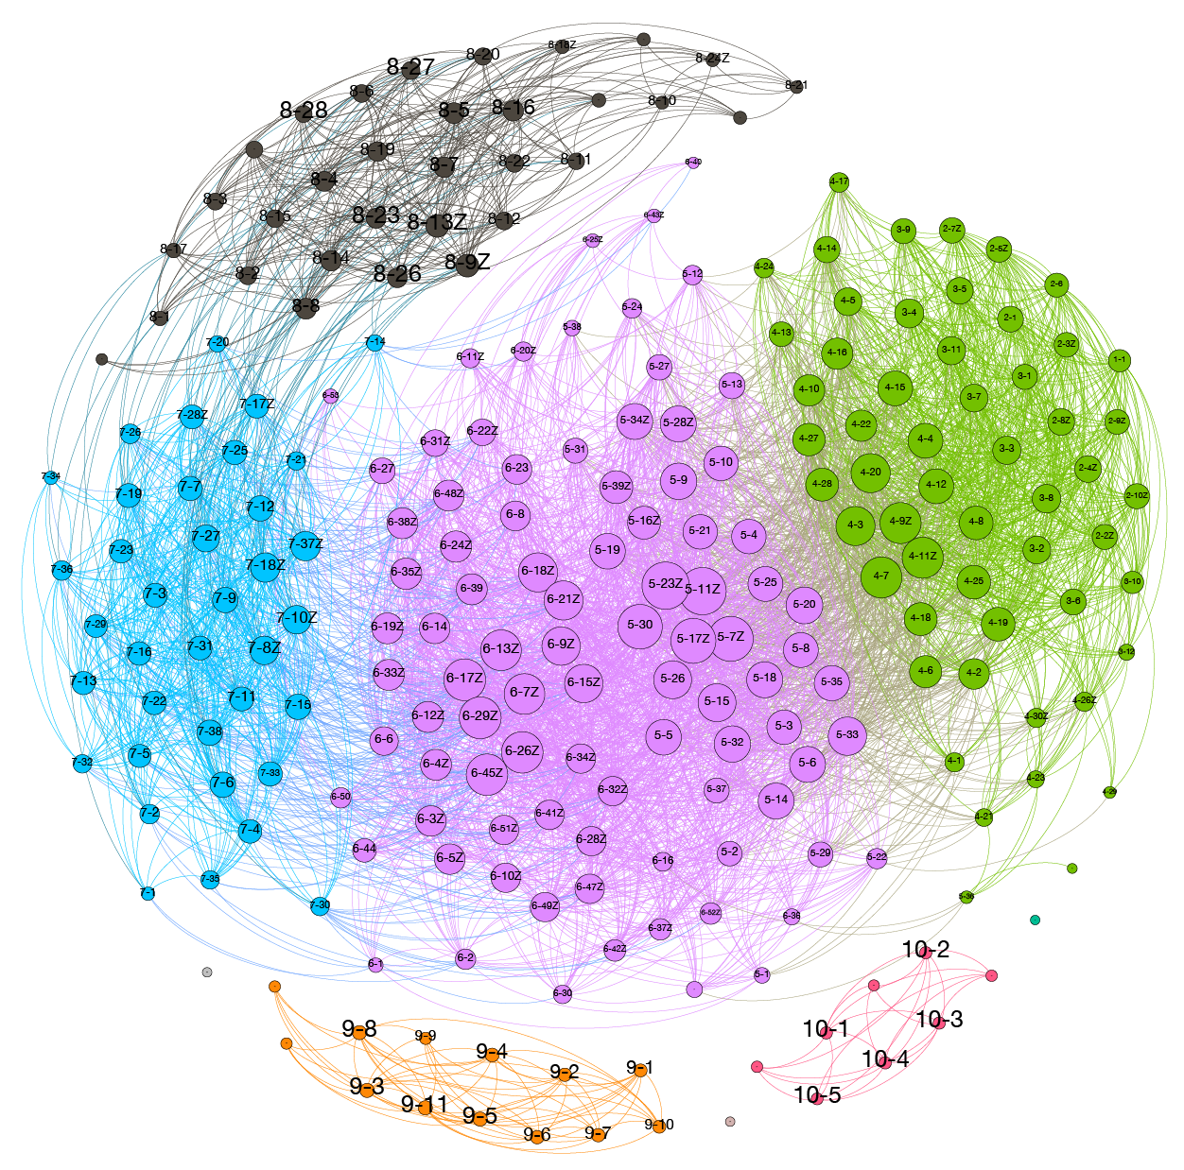
Topology of the 12TET interval vector space
Classification based on distances between IVs
Nodes are connected for distances larger than 1 and less or equal 4

Slide 8
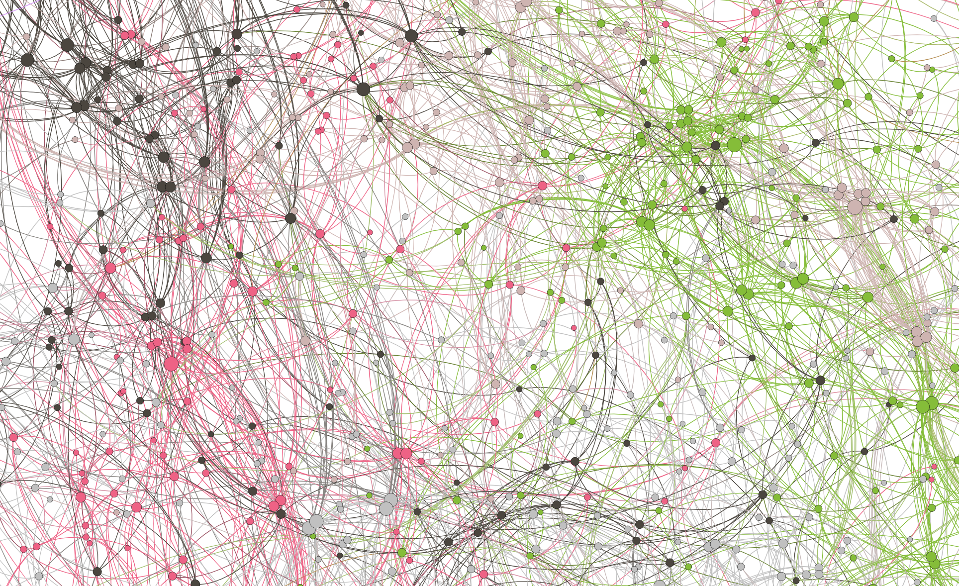
Topology of the 7-pitch class sets of the
24TET interval vector space
7478 unique prime forms with 1715 Z-related sets
Classification based on distances between IVs
Nodes are connected for distances up to O(2) and O(1,1,1,1) (distance=2)

Slide 9
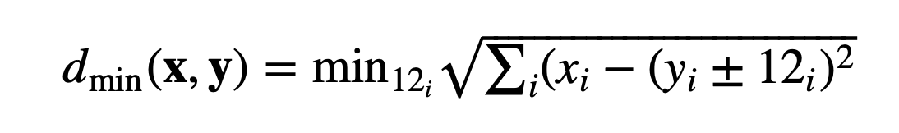
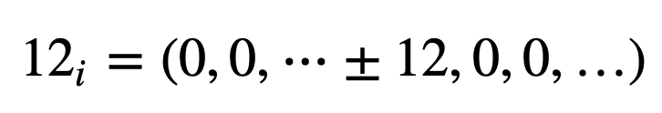
Topology of the voice leading vector spaces
Classification based on minimal distance between pcs of same cardinality
Start from normal ordered pcs x and y of same cardinality (w/o allowing repetitions of pitches – bijective or non bijective)
Calculate the minimal distance as
where 12_{i} is a vector of all zeros but ±12 at position i for all permutations of i:
Minimal hand motion on keyboard

Slide 10
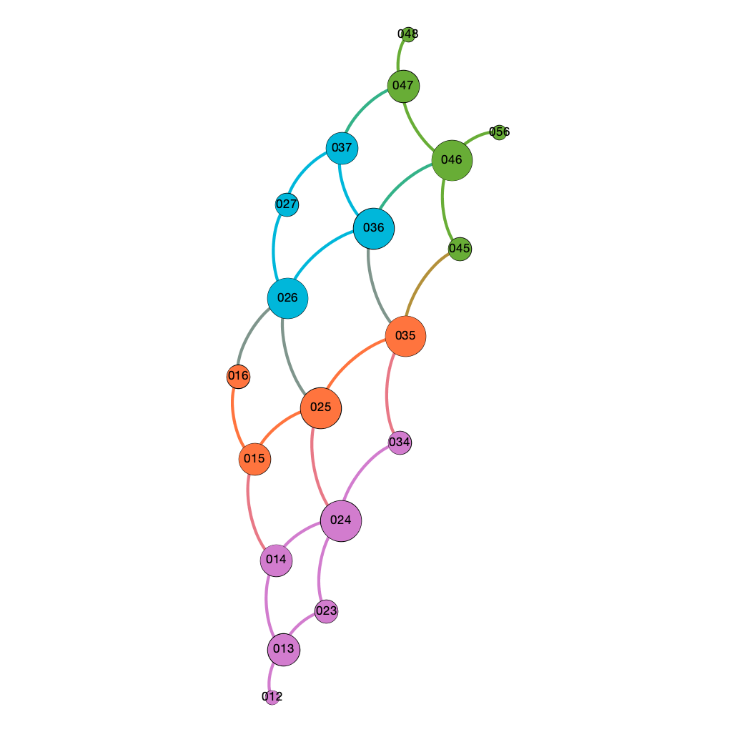
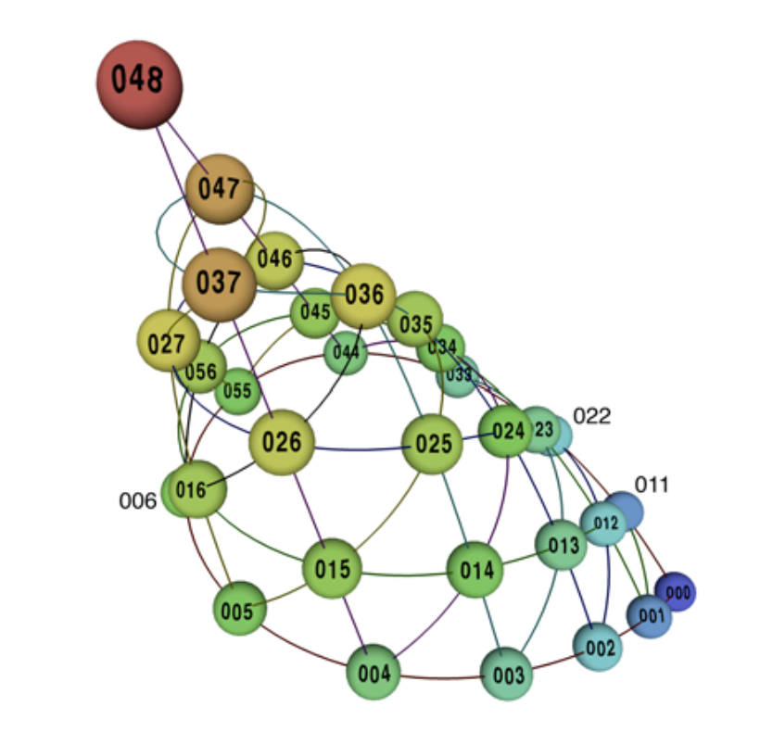
Triadic harmony in 12TET
Classification based on minimal distance between pcs of cardinality 3
Octave equivalent normal forms (prime forms + inversions) + O(1)
aug
min
Maj
add2
Quotient space 𝕋²/𝒮₃ as a cone
dim
Maj b5
All the information is contained in the metric!
Callender, Quinn and Tymoczko, Science 320, 346 (2008)

Slide 11
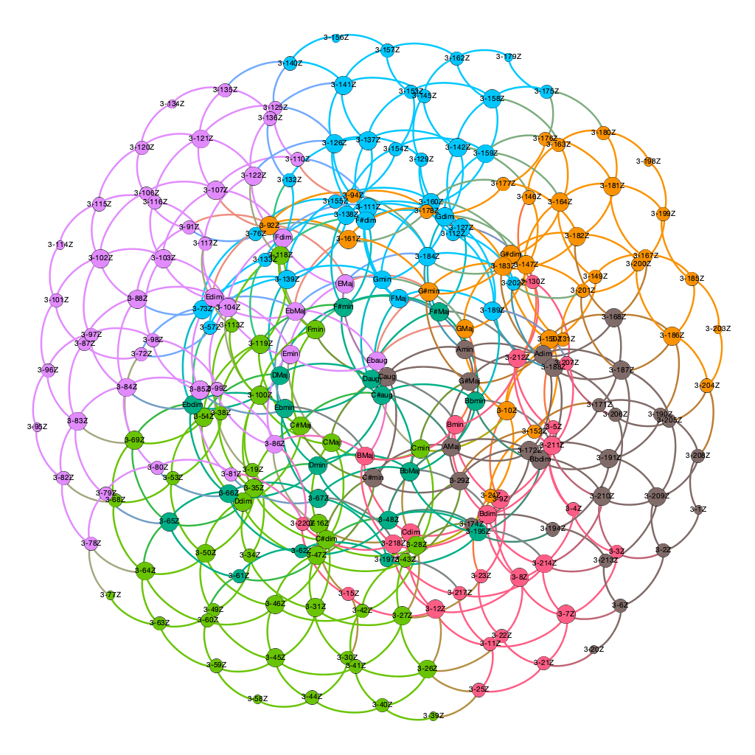
panchromatic normal forms (prime forms + inversions) + O(1)
Triadic harmony in 12TET
panchromatic voice leading spaces

Slide 12
Triadic harmony in 12TET
panchromatic voice leading spaces
Even some more on distances!
Order of operator is related to functionality in the voice leading space:
operator | distance | weight
O(1) | 1.0000 | 1.0000
O(1,1) | 1.4142 | 0.7071
O(1,1,1) | 1.7321 | 0.5774
O(2) | 2.0000 | 0.5000
O(1,2) | 2.2361 | 0.4472
O(2,1,1) | 2.4494 | 0.4083
O(2,2) | 2.8284 | 0.3536
O(2,2,1) | 3.0000 | 0.3333
O(3) | 3.0000 | 0.3333
O(1,3) | 3.1622 | 0.3162
O(1,1,3) | 3.3166 | 0.3015
O(2,2,2) | 3.4641 | 0.2886
O(2,3) | 3.6056 | 0.2774
O(1,2,3) | 3.7416 | 0.2673
O(4) | 4.0000 | 0.2500
aug ⇨ Maj ⇨ min ⇨ dim, etc.
Color of nodes = modularity class ➝ measure of the strength of division of a network into communities: dense connections between the nodes within communities but sparse connections between nodes in different communities.

Slide 13
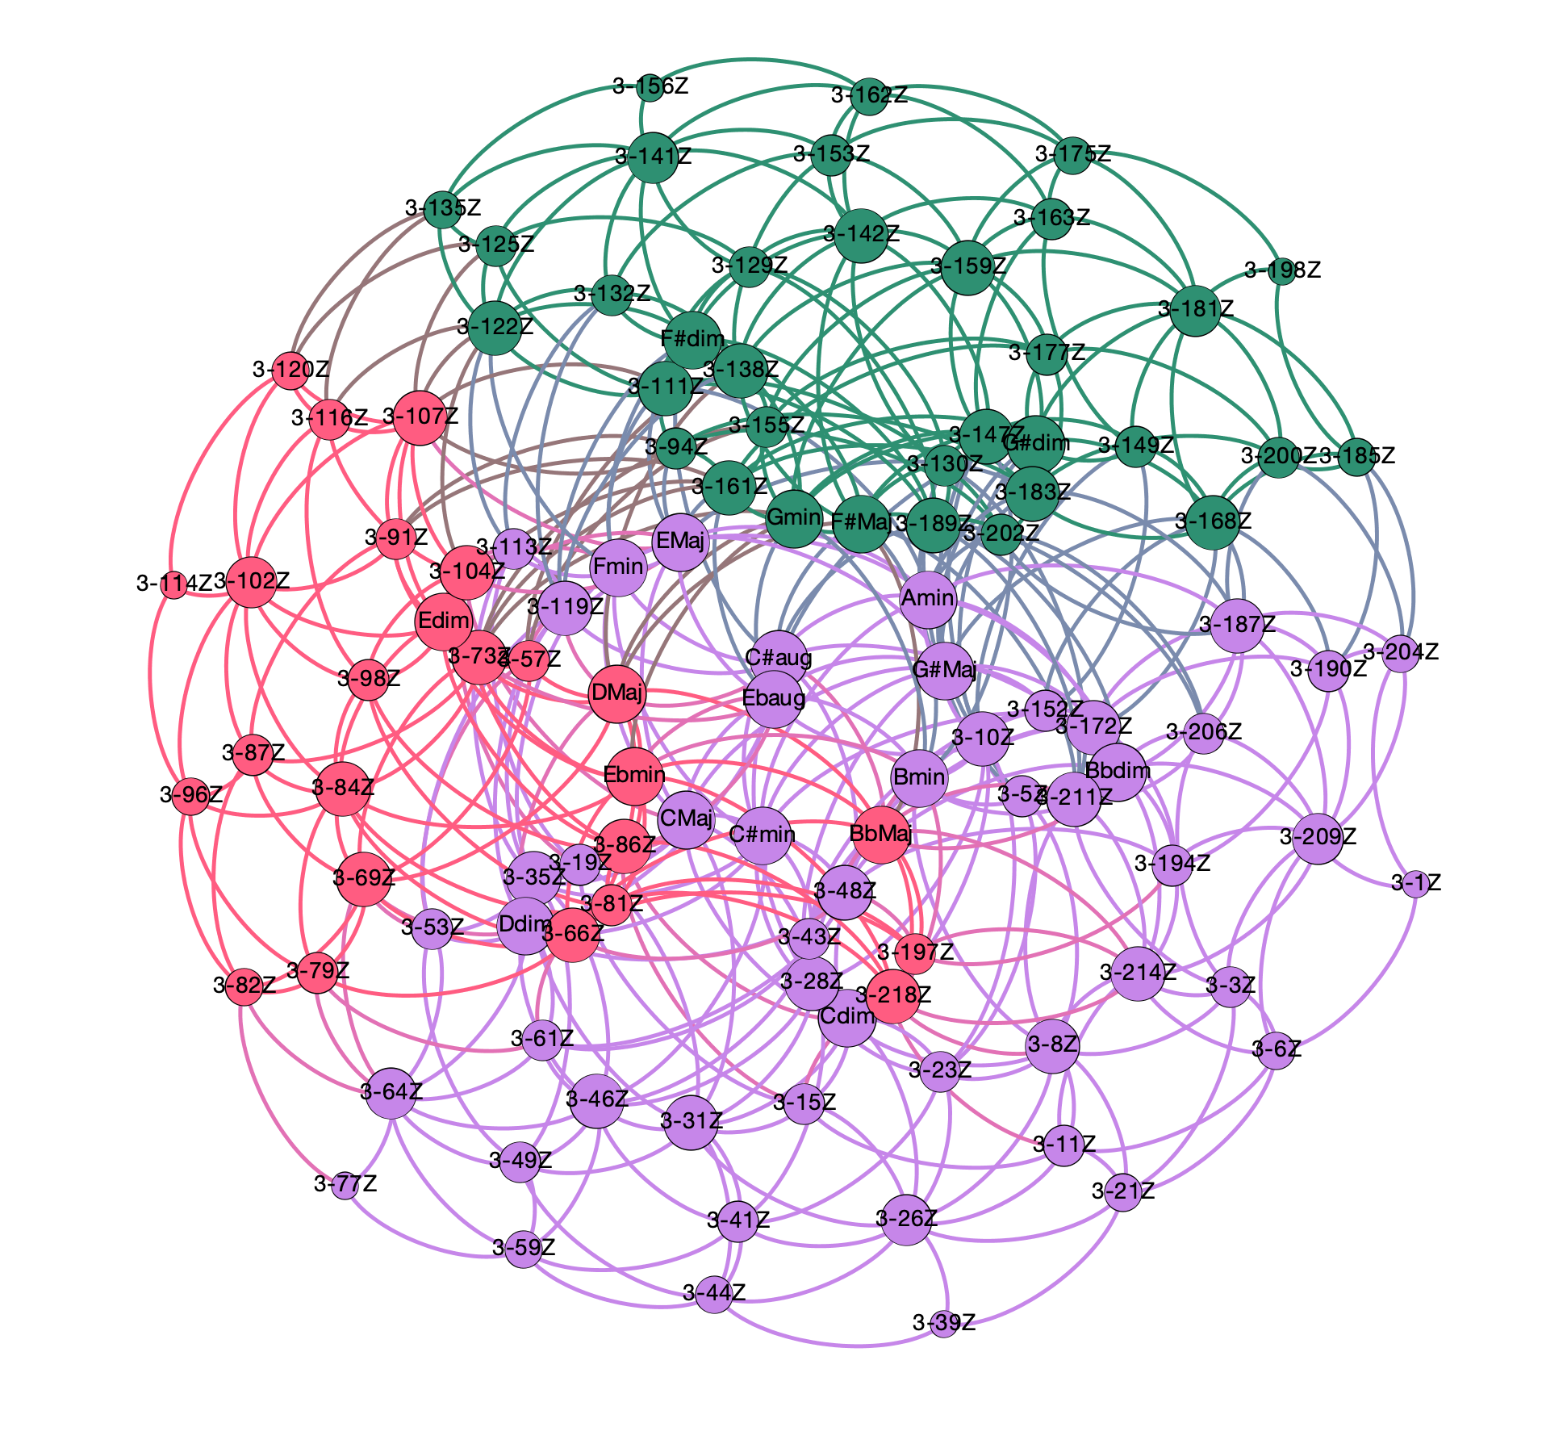
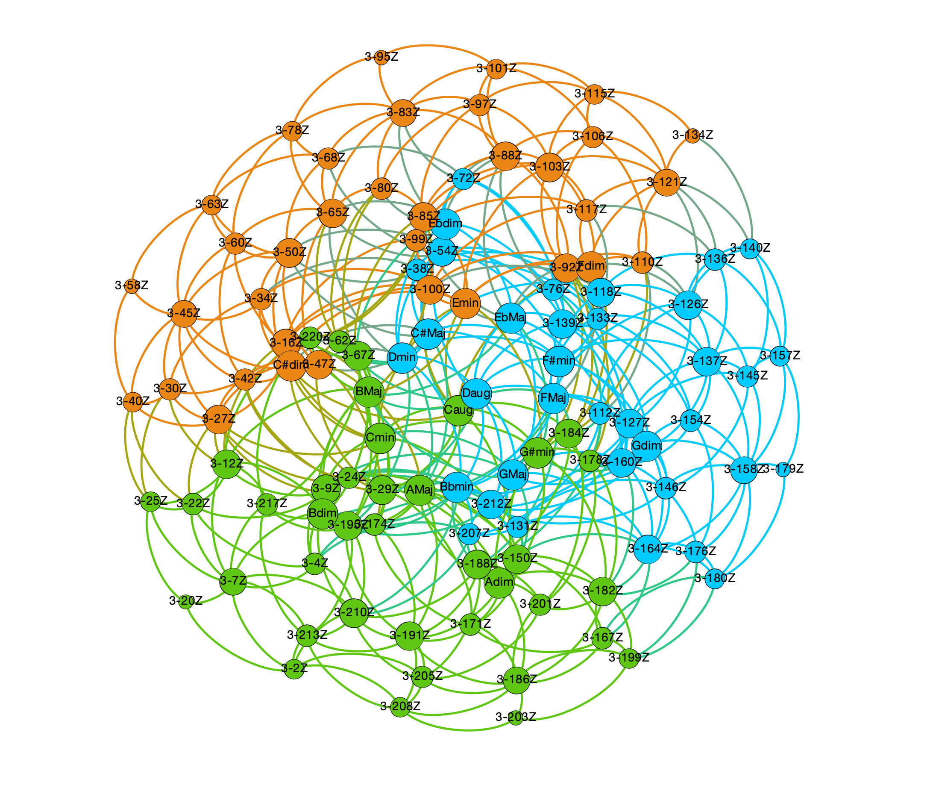
panchromatic normal forms (prime forms + inversions) + O(1+1)
Maj | Min | dim
C# | A# | C#
Eb | C | Eb
F | D | F
G | E | G
A | F# | A
B | G# | B
Triadic harmony in 12TET
panchromatic voice leading spaces
Maj | Min | dim
C | A | C
D | B | D
E | C# | E
F# | Eb | F#
G# | F | G#
Bb | G | Bb

Slide 14
Triadic harmony in 12TET
panchromatic voice leading spaces
Even some more on distances!
Order of operator is related to functionality in the voice leading space:
operator | distance | weight
O(1) | 1.0000 | 1.0000
O(1,1) | 1.4142 | 0.7071
O(1,1,1) | 1.7321 | 0.5774
O(2) | 2.0000 | 0.5000
O(1,2) | 2.2361 | 0.4472
O(2,1,1) | 2.4494 | 0.4083
O(2,2) | 2.8284 | 0.3536
O(2,2,1) | 3.0000 | 0.3333
O(3) | 3.0000 | 0.3333
O(1,3) | 3.1622 | 0.3162
O(1,1,3) | 3.3166 | 0.3015
O(2,2,2) | 3.4641 | 0.2886
O(2,3) | 3.6056 | 0.2774
O(1,2,3) | 3.7416 | 0.2673
O(4) | 4.0000 | 0.2500
aug ⇨ Maj ⇨ min ⇨ dim, etc.
Cmaj ⇨ Fmin ⇨ F#dim ⇨ F#Maj, etc.
Color of nodes = modularity class ➝ measure of the strength of division of a network into communities: dense connections between the nodes within communities but sparse connections between nodes in different communities.

Slide 15
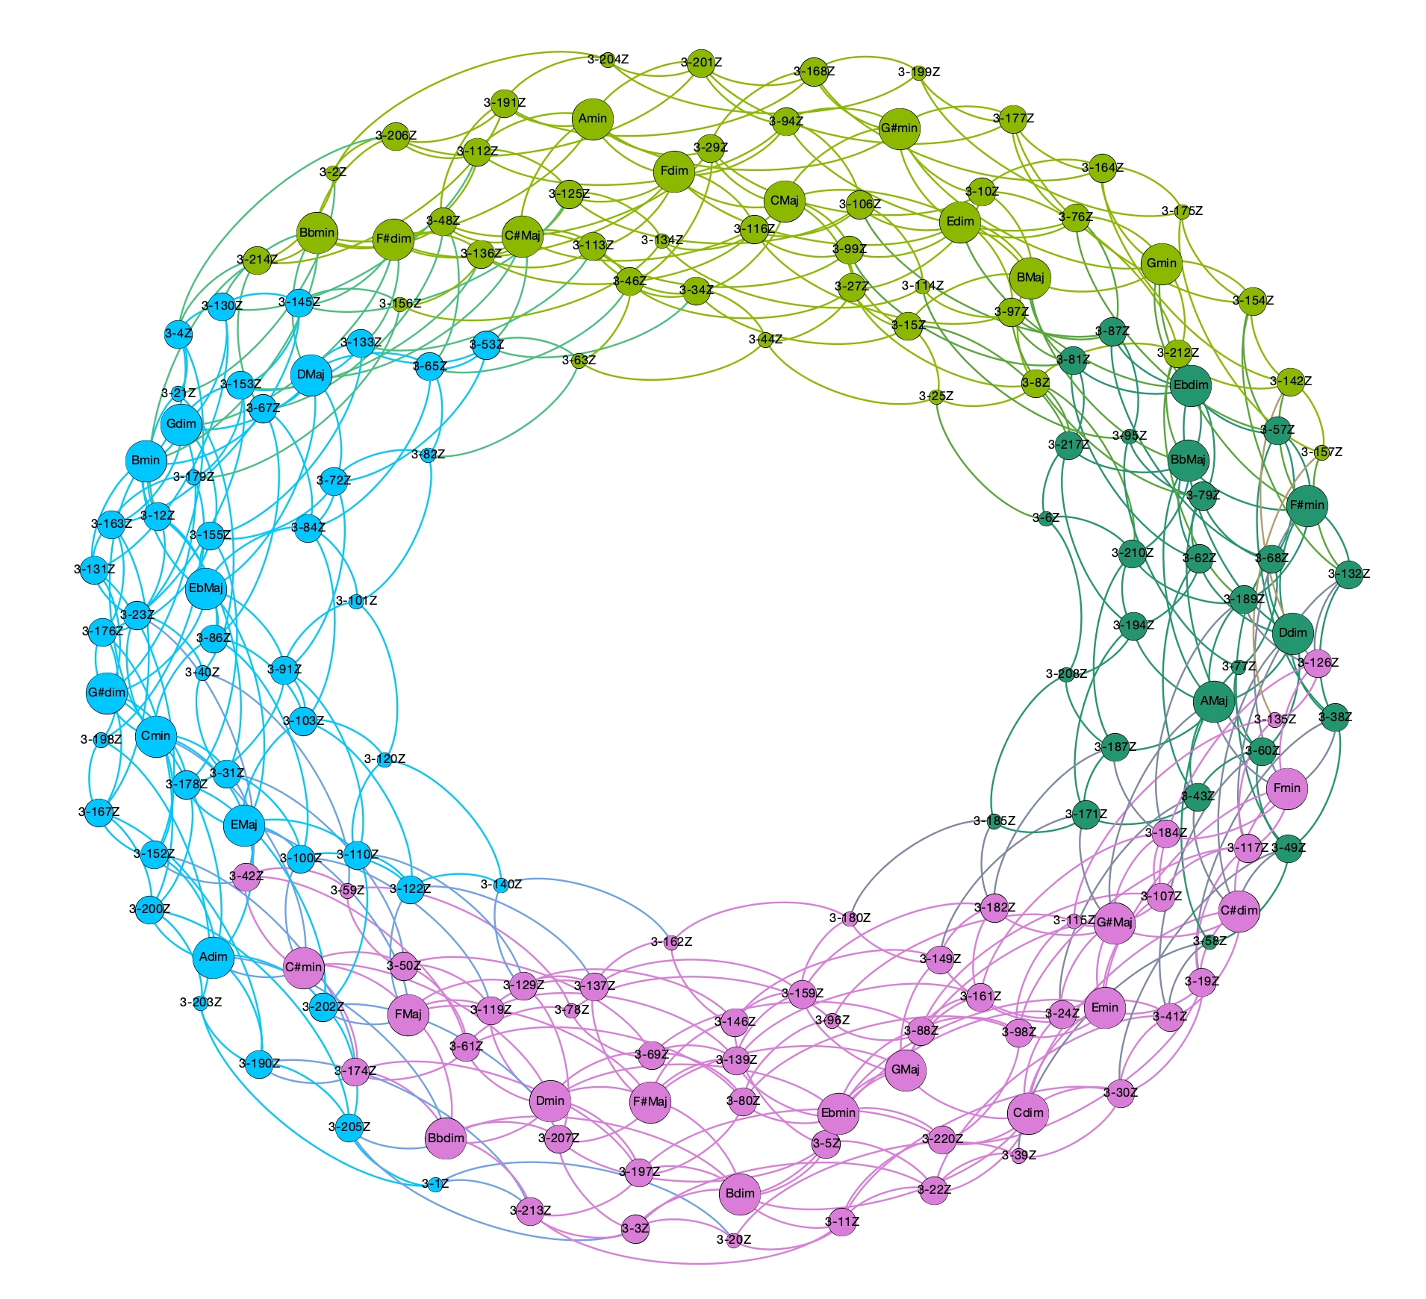
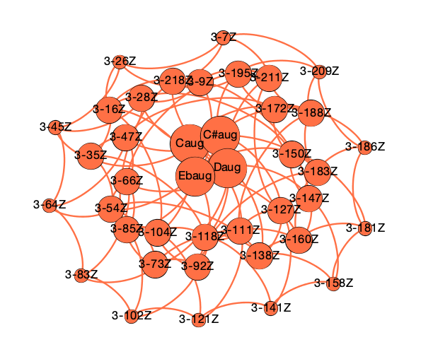
panchromatic normal forms (prime forms + inversions) + O(1+1+1)
Triadic harmony in 12TET
panchromatic voice leading spaces

Slide 16
Triadic harmony in 12TET
panchromatic voice leading spaces
Even some more on distances!
Order of operator is related to functionality in the voice leading space:
operator | distance | weight
O(1) | 1.0000 | 1.0000
O(1,1) | 1.4142 | 0.7071
O(1,1,1) | 1.7321 | 0.5774
O(2) | 2.0000 | 0.5000
O(1,2) | 2.2361 | 0.4472
O(2,1,1) | 2.4494 | 0.4083
O(2,2) | 2.8284 | 0.3536
O(2,2,1) | 3.0000 | 0.3333
O(3) | 3.0000 | 0.3333
O(1,3) | 3.1622 | 0.3162
O(1,1,3) | 3.3166 | 0.3015
O(2,2,2) | 3.4641 | 0.2886
O(2,3) | 3.6056 | 0.2774
O(1,2,3) | 3.7416 | 0.2673
O(4) | 4.0000 | 0.2500
aug ⇨ Maj ⇨ min ⇨ dim, etc.
Cmaj ⇨ Fmin ⇨ F#dim ⇨ F#Maj, etc.
Maj ⇨ Maj or min ⇨ min or Cmaj ⇨ F#dim ⇨ Amin, etc.
Color of nodes = modularity class ➝ measure of the strength of division of a network into communities: dense connections between the nodes within communities but sparse connections between nodes in different communities.

Slide 17
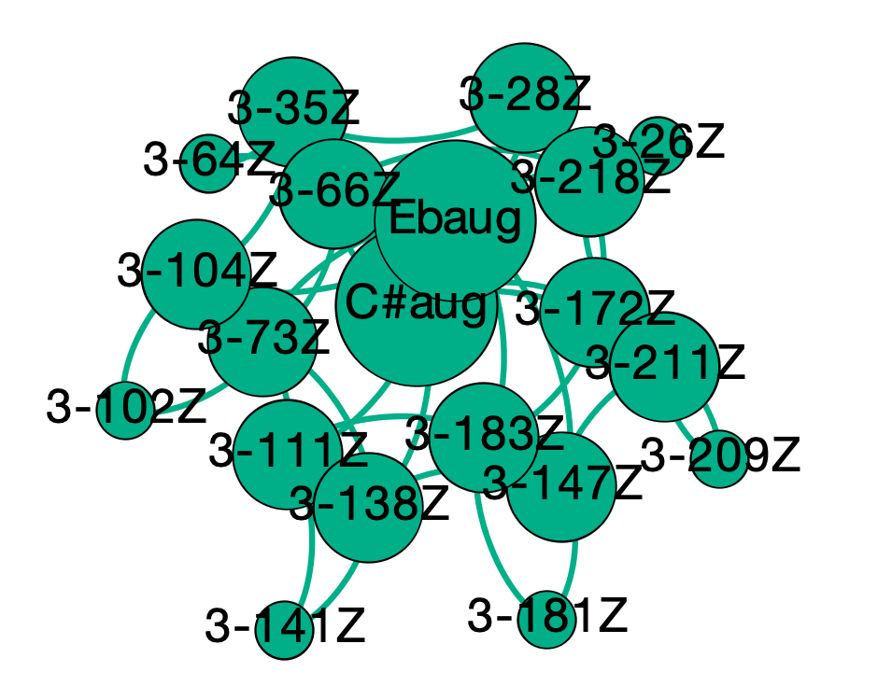
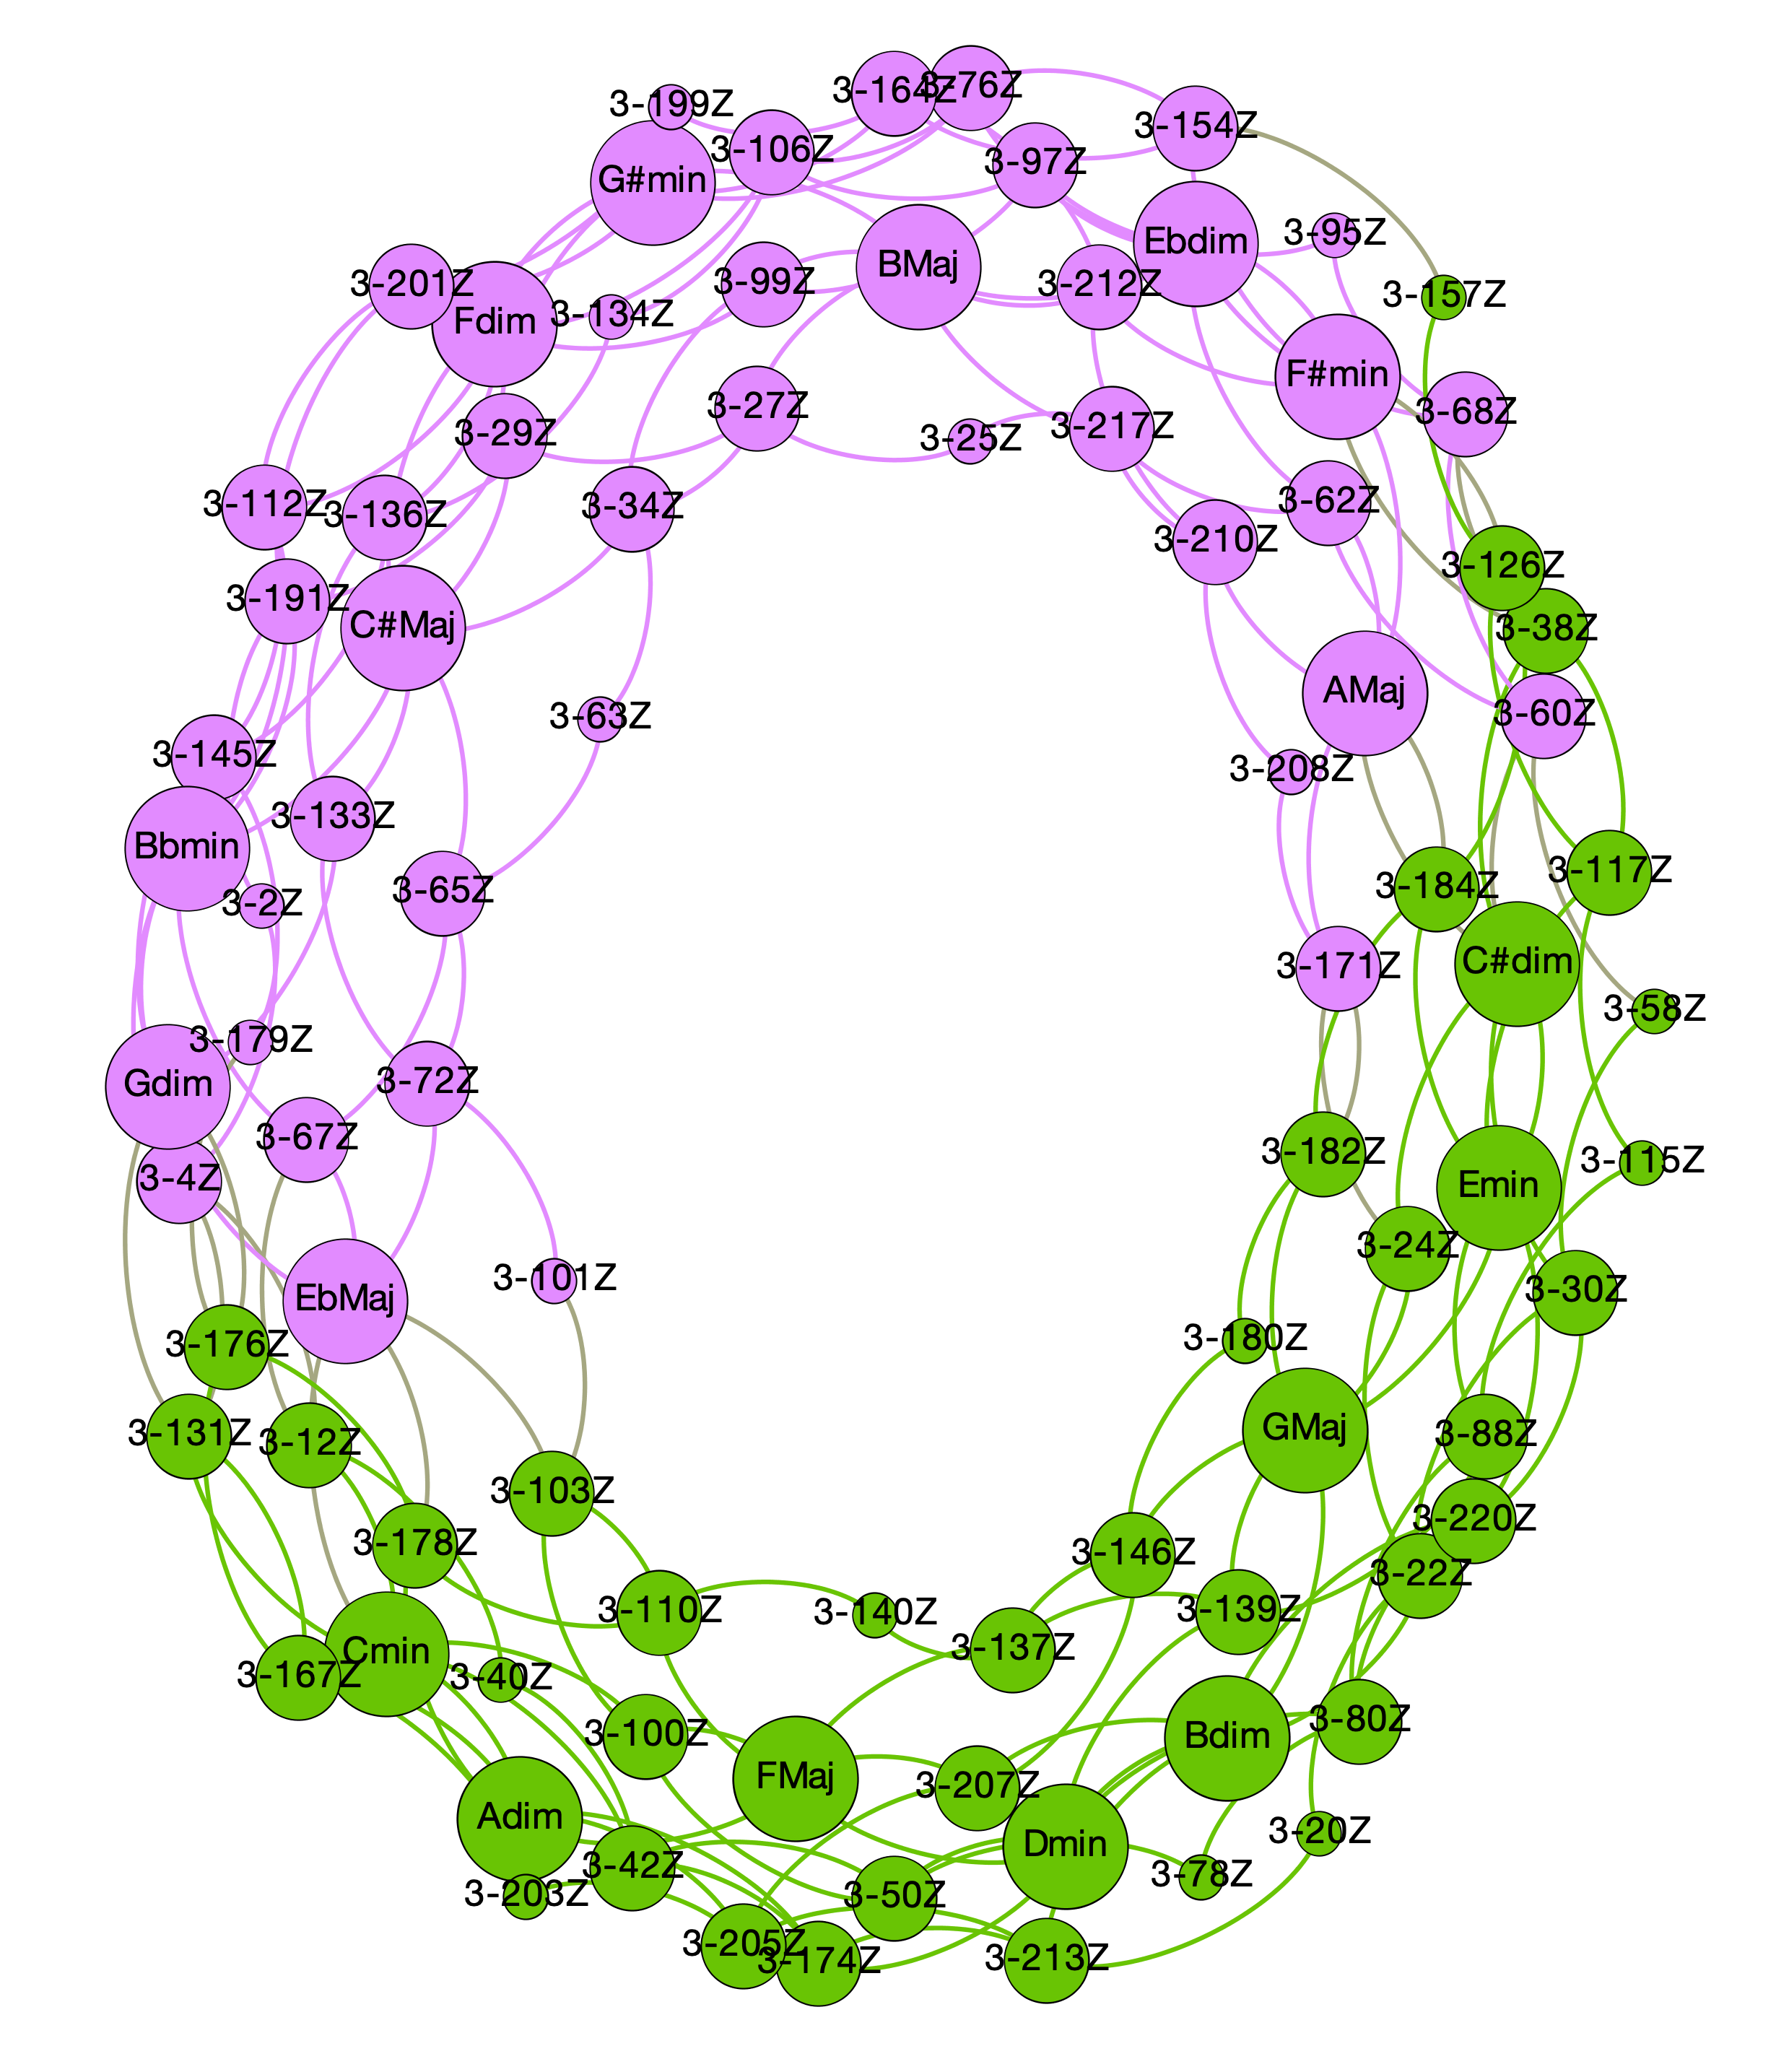
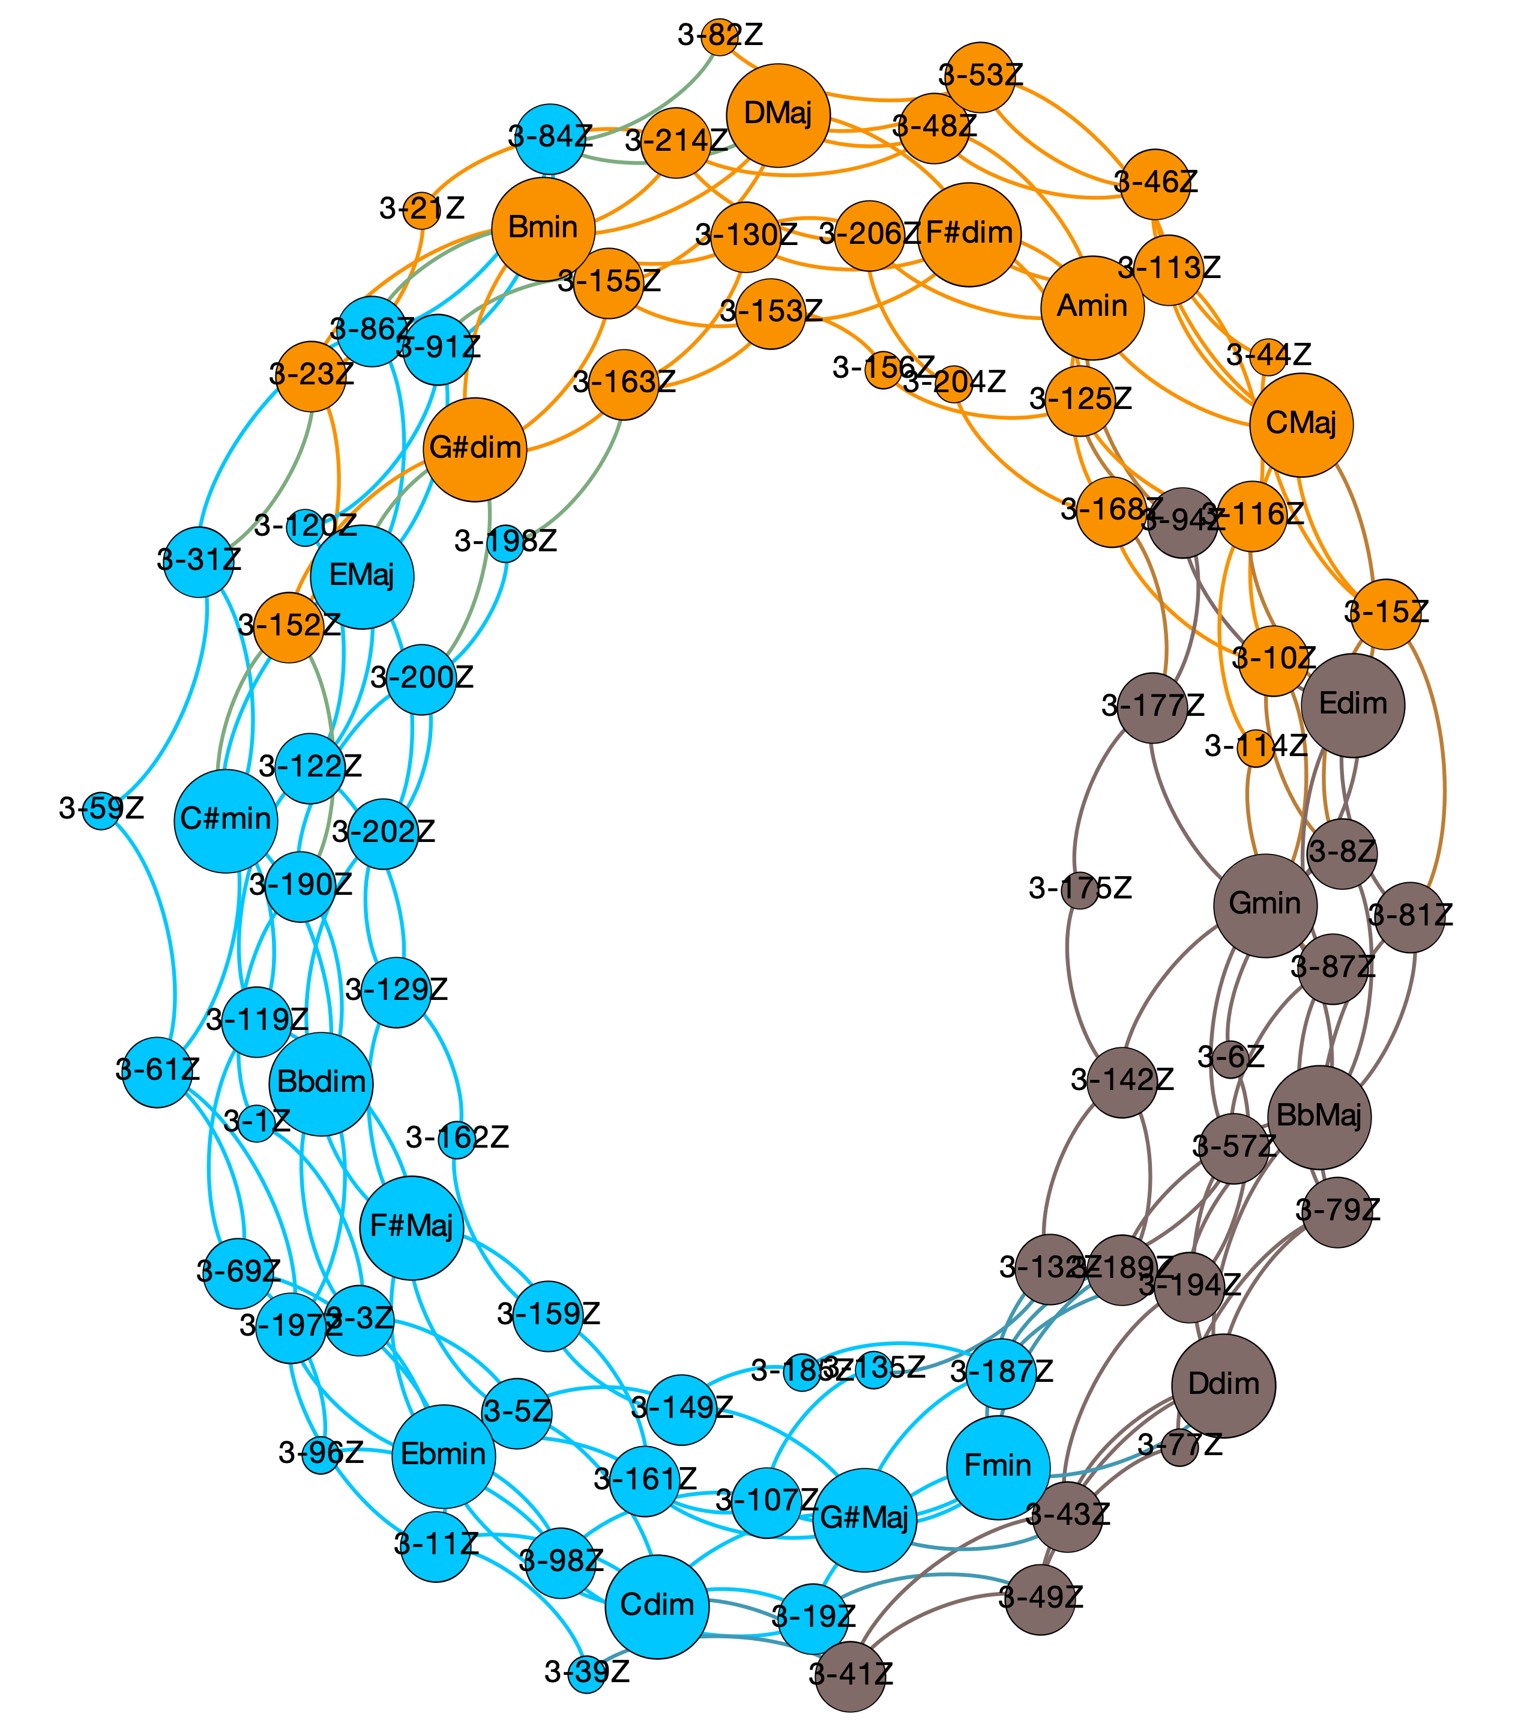
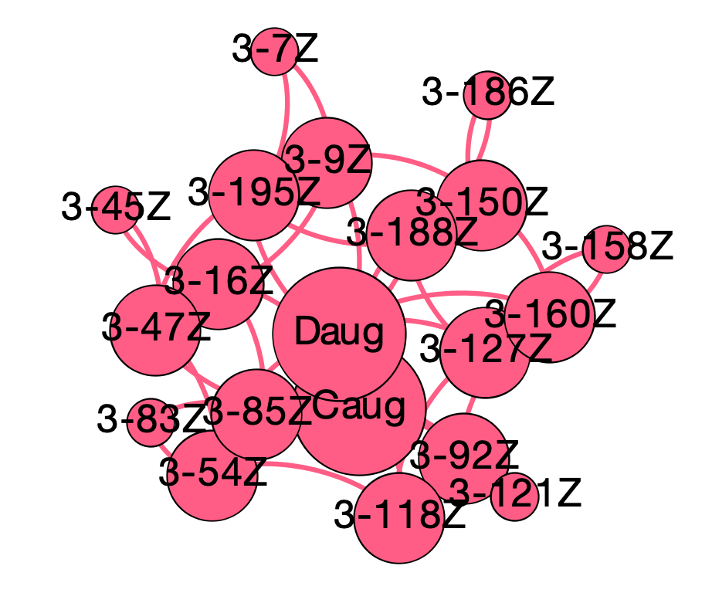
panchromatic normal forms (prime forms + inversions) + O(2)
Triadic harmony in 12TET
panchromatic voice leading spaces

Slide 18
Triadic harmony in 12TET
panchromatic voice leading spaces
Even some more on distances!
Order of operator is related to functionality in the voice leading space:
operator | distance | weight
O(1) | 1.0000 | 1.0000
O(1,1) | 1.4142 | 0.7071
O(1,1,1) | 1.7321 | 0.5774
O(2) | 2.0000 | 0.5000
O(1,2) | 2.2361 | 0.4472
O(2,1,1) | 2.4494 | 0.4083
O(2,2) | 2.8284 | 0.3536
O(2,2,1) | 3.0000 | 0.3333
O(3) | 3.0000 | 0.3333
O(1,3) | 3.1622 | 0.3162
O(1,1,3) | 3.3166 | 0.3015
O(2,2,2) | 3.4641 | 0.2886
O(2,3) | 3.6056 | 0.2774
O(1,2,3) | 3.7416 | 0.2673
O(4) | 4.0000 | 0.2500
aug ⇨ Maj ⇨ min ⇨ dim, etc.
Cmaj ⇨ Fmin ⇨ F#dim ⇨ F#Maj, etc.
Maj ⇨ Maj or min ⇨ min or Cmaj ⇨ F#dim ⇨ Amin, etc.
Cmaj ⇨ Amin ⇨ F#dim ⇨ Dmaj, etc.
Color of nodes = modularity class ➝ measure of the strength of division of a network into communities: dense connections between the nodes within communities but sparse connections between nodes in different communities.

Slide 19
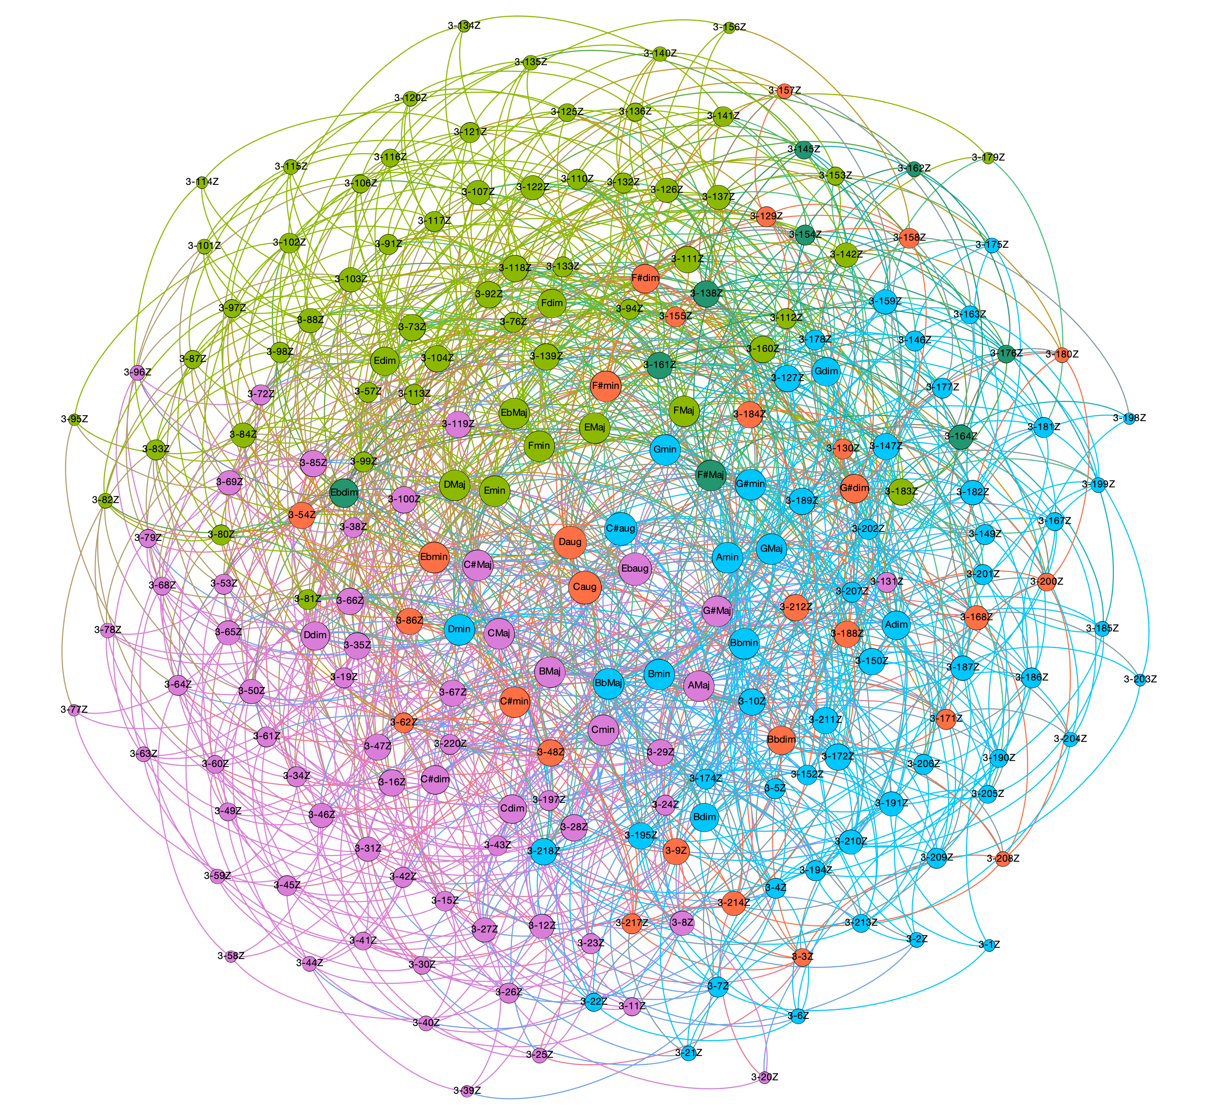
panchromatic normal forms (prime forms + inversions) + O(1+2)
Triadic harmony in 12TET
panchromatic voice leading spaces

Slide 20
Triadic harmony in 12TET
panchromatic voice leading spaces
Even some more on distances!
Order of operator is related to functionality in the voice leading space:
operator | distance | weight
O(1) | 1.0000 | 1.0000
O(1,1) | 1.4142 | 0.7071
O(1,1,1) | 1.7321 | 0.5774
O(2) | 2.0000 | 0.5000
O(1,2) | 2.2361 | 0.4472
O(2,1,1) | 2.4494 | 0.4083
O(2,2) | 2.8284 | 0.3536
O(2,2,1) | 3.0000 | 0.3333
O(3) | 3.0000 | 0.3333
O(1,3) | 3.1622 | 0.3162
O(1,1,3) | 3.3166 | 0.3015
O(2,2,2) | 3.4641 | 0.2886
O(2,3) | 3.6056 | 0.2774
O(1,2,3) | 3.7416 | 0.2673
O(4) | 4.0000 | 0.2500
aug ⇨ Maj ⇨ min ⇨ dim, etc.
Cmaj ⇨ Fmin ⇨ F#dim ⇨ F#Maj, etc.
Maj ⇨ Maj or min ⇨ min or Cmaj ⇨ F#dim ⇨ Amin, etc.
Cmaj ⇨ Amin ⇨ F#dim ⇨ Dmaj, etc.
Circle of fifths
etc.
Color of nodes = modularity class ➝ measure of the strength of division of a network into communities: dense connections between the nodes within communities but sparse connections between nodes in different communities.

Slide 21
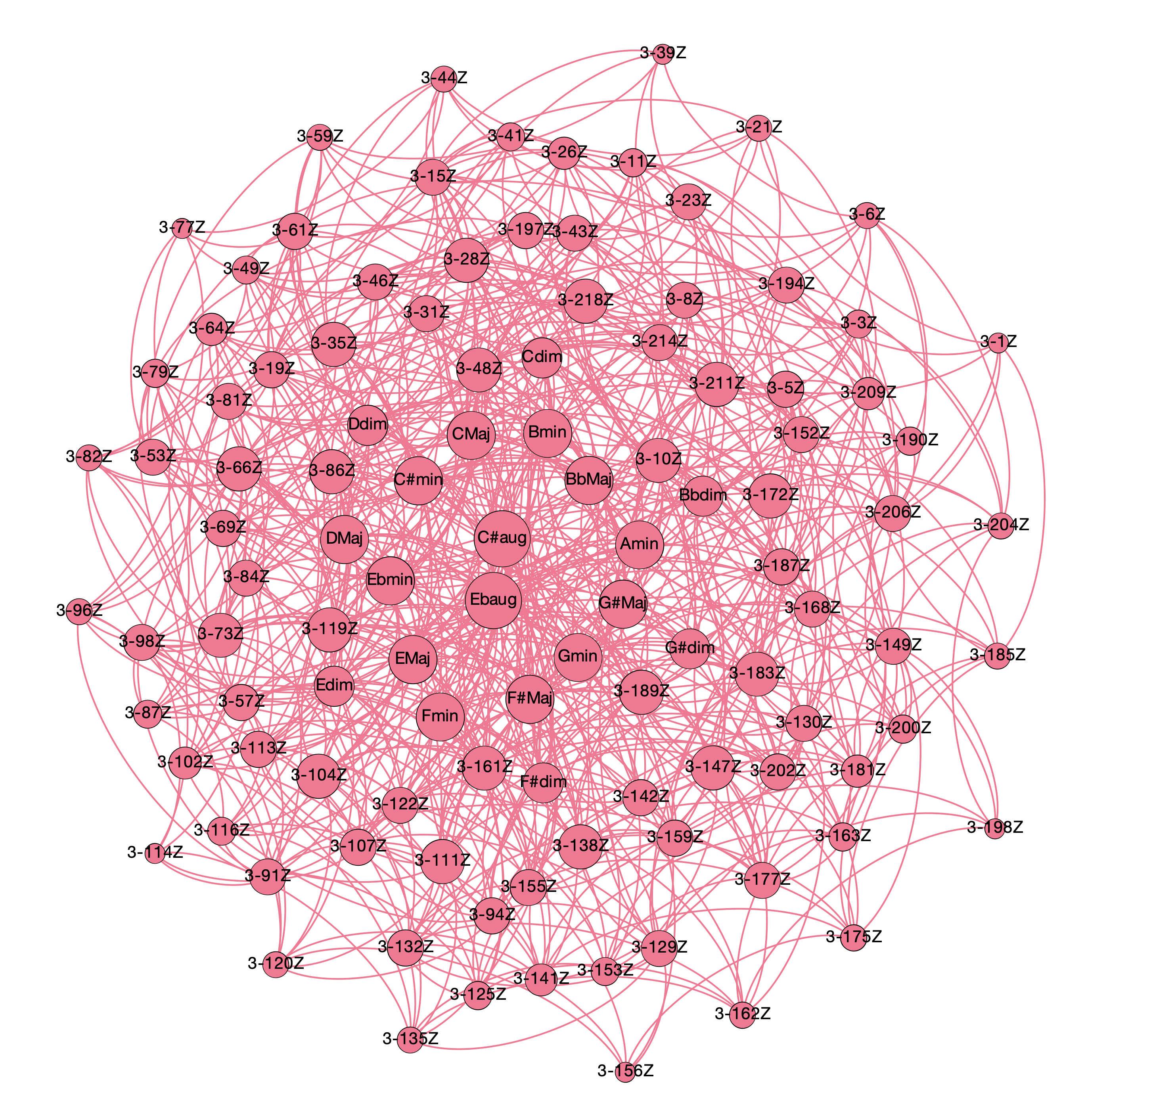
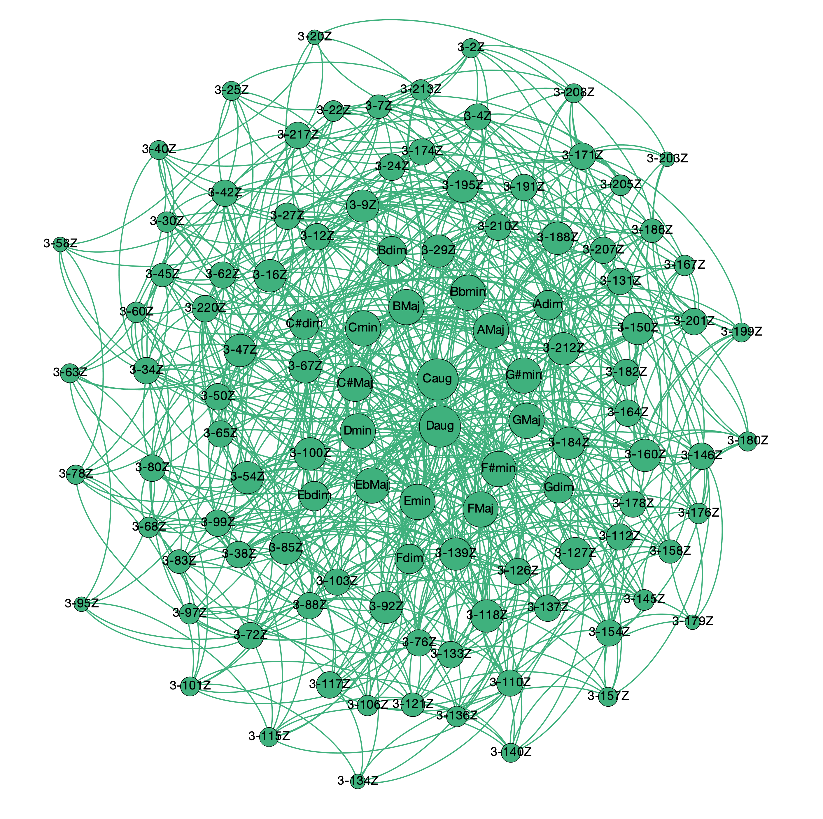
panchromatic normal forms (prime forms + inversions) + O(1+1+2)
Triadic harmony in 12TET
panchromatic voice leading spaces

Slide 22
Triadic harmony in 12TET
panchromatic voice leading spaces
Even some more on distances!
Order of operator is related to functionality in the voice leading space:
operator | distance | weight
O(1) | 1.0000 | 1.0000
O(1,1) | 1.4142 | 0.7071
O(1,1,1) | 1.7321 | 0.5774
O(2) | 2.0000 | 0.5000
O(1,2) | 2.2361 | 0.4472
O(2,1,1) | 2.4494 | 0.4083
O(2,2) | 2.8284 | 0.3536
O(2,2,1) | 3.0000 | 0.3333
O(3) | 3.0000 | 0.3333
O(1,3) | 3.1622 | 0.3162
O(1,1,3) | 3.3166 | 0.3015
O(2,2,2) | 3.4641 | 0.2886
O(2,3) | 3.6056 | 0.2774
O(1,2,3) | 3.7416 | 0.2673
O(4) | 4.0000 | 0.2500
aug ⇨ Maj ⇨ min ⇨ dim, etc.
Cmaj ⇨ Fmin ⇨ F#dim ⇨ F#Maj, etc.
Maj ⇨ Maj or min ⇨ min or Cmaj ⇨ F#dim ⇨ Amin, etc.
Cmaj ⇨ Amin ⇨ F#dim ⇨ Dmaj, etc.
Circle of fifths
etc.
Color of nodes = modularity class ➝ measure of the strength of division of a network into communities: dense connections between the nodes within communities but sparse connections between nodes in different communities.

Slide 23
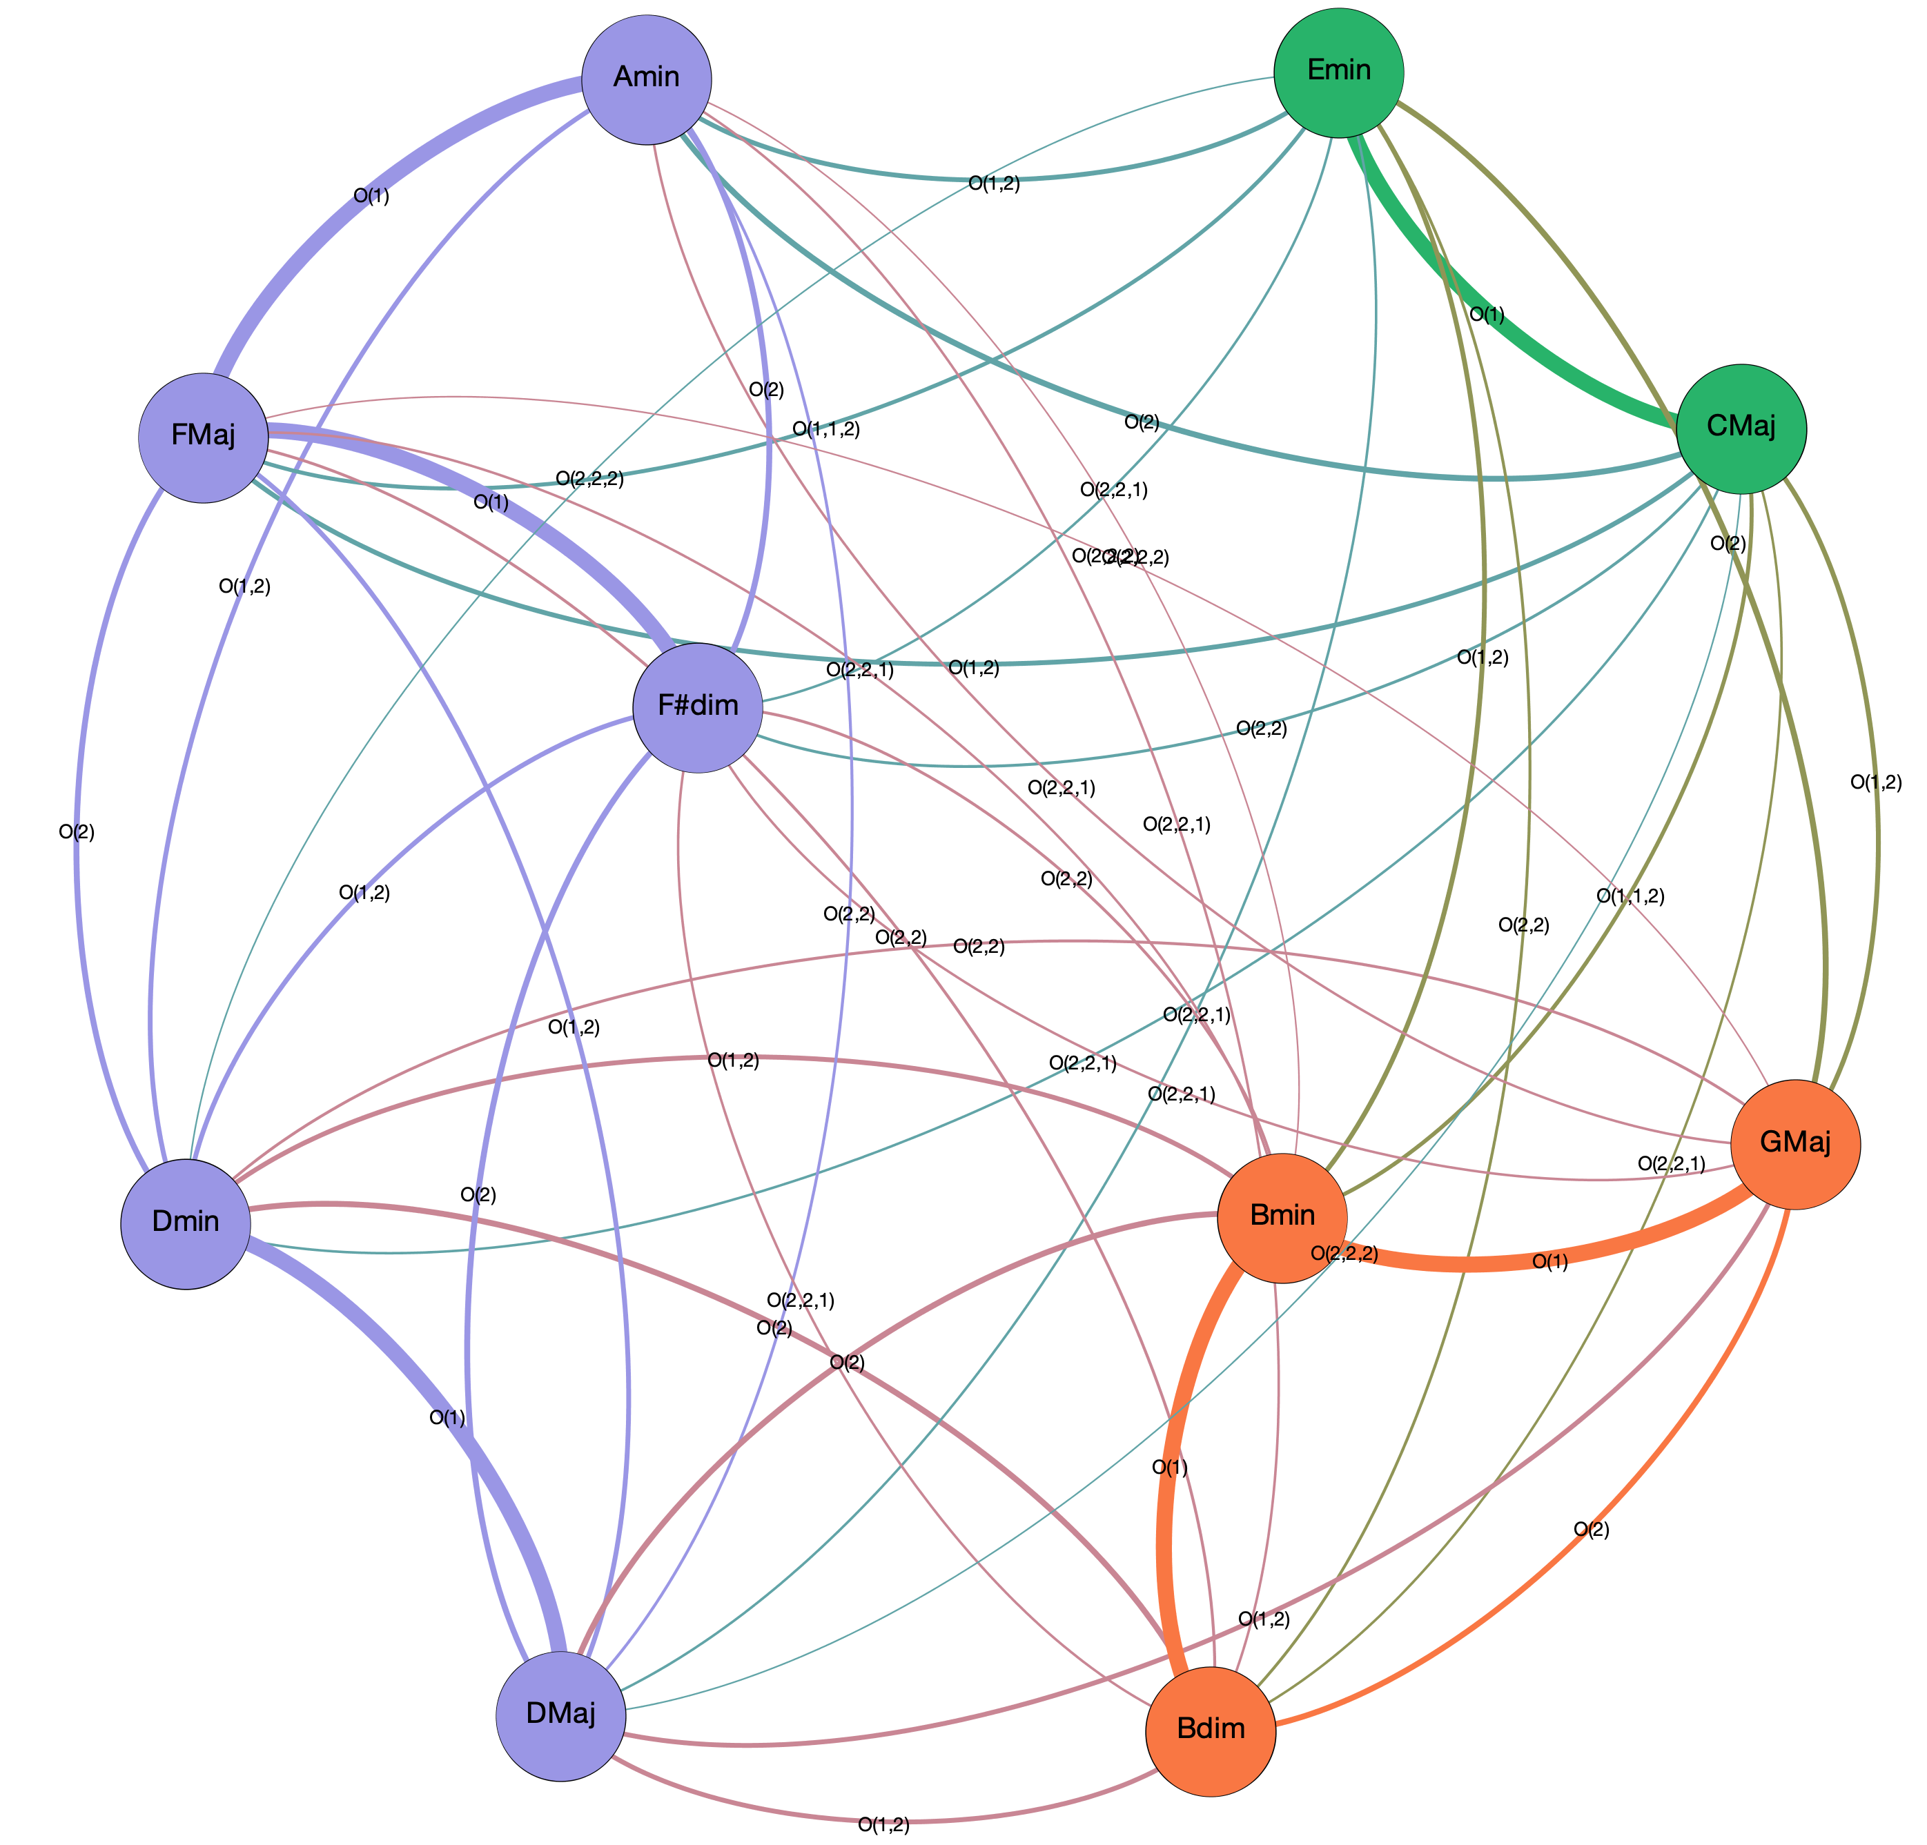
Subspaces of voice leading spaces: tonal spaces and common practice harmony
Subspace of C Maj and G Maj keys – diatonic triads
Defines a subset in the operator space:
O(1)
O(2)
O(1,2)
O(1,2,2)
O(2,2)
O(2,2,2)
For instance, this graph contains all the information needed to construct modulation sequences in the union of the C Maj and G Maj keys subspaces

Slide 24
Subspaces of voice leading spaces: tonal spaces and common practice harmony
Measure of the “strength” (parsimony*) of a progression as sum of the weights of the connecting segments:
FMaj ⇨ F#dim ⇨ GMaj
strength = 1.3333
Fmaj ⇨ Dmaj ⇨ GMaj
strength = 0.8944
*see Tymoczko, Science 313 (2006)

Slide 25
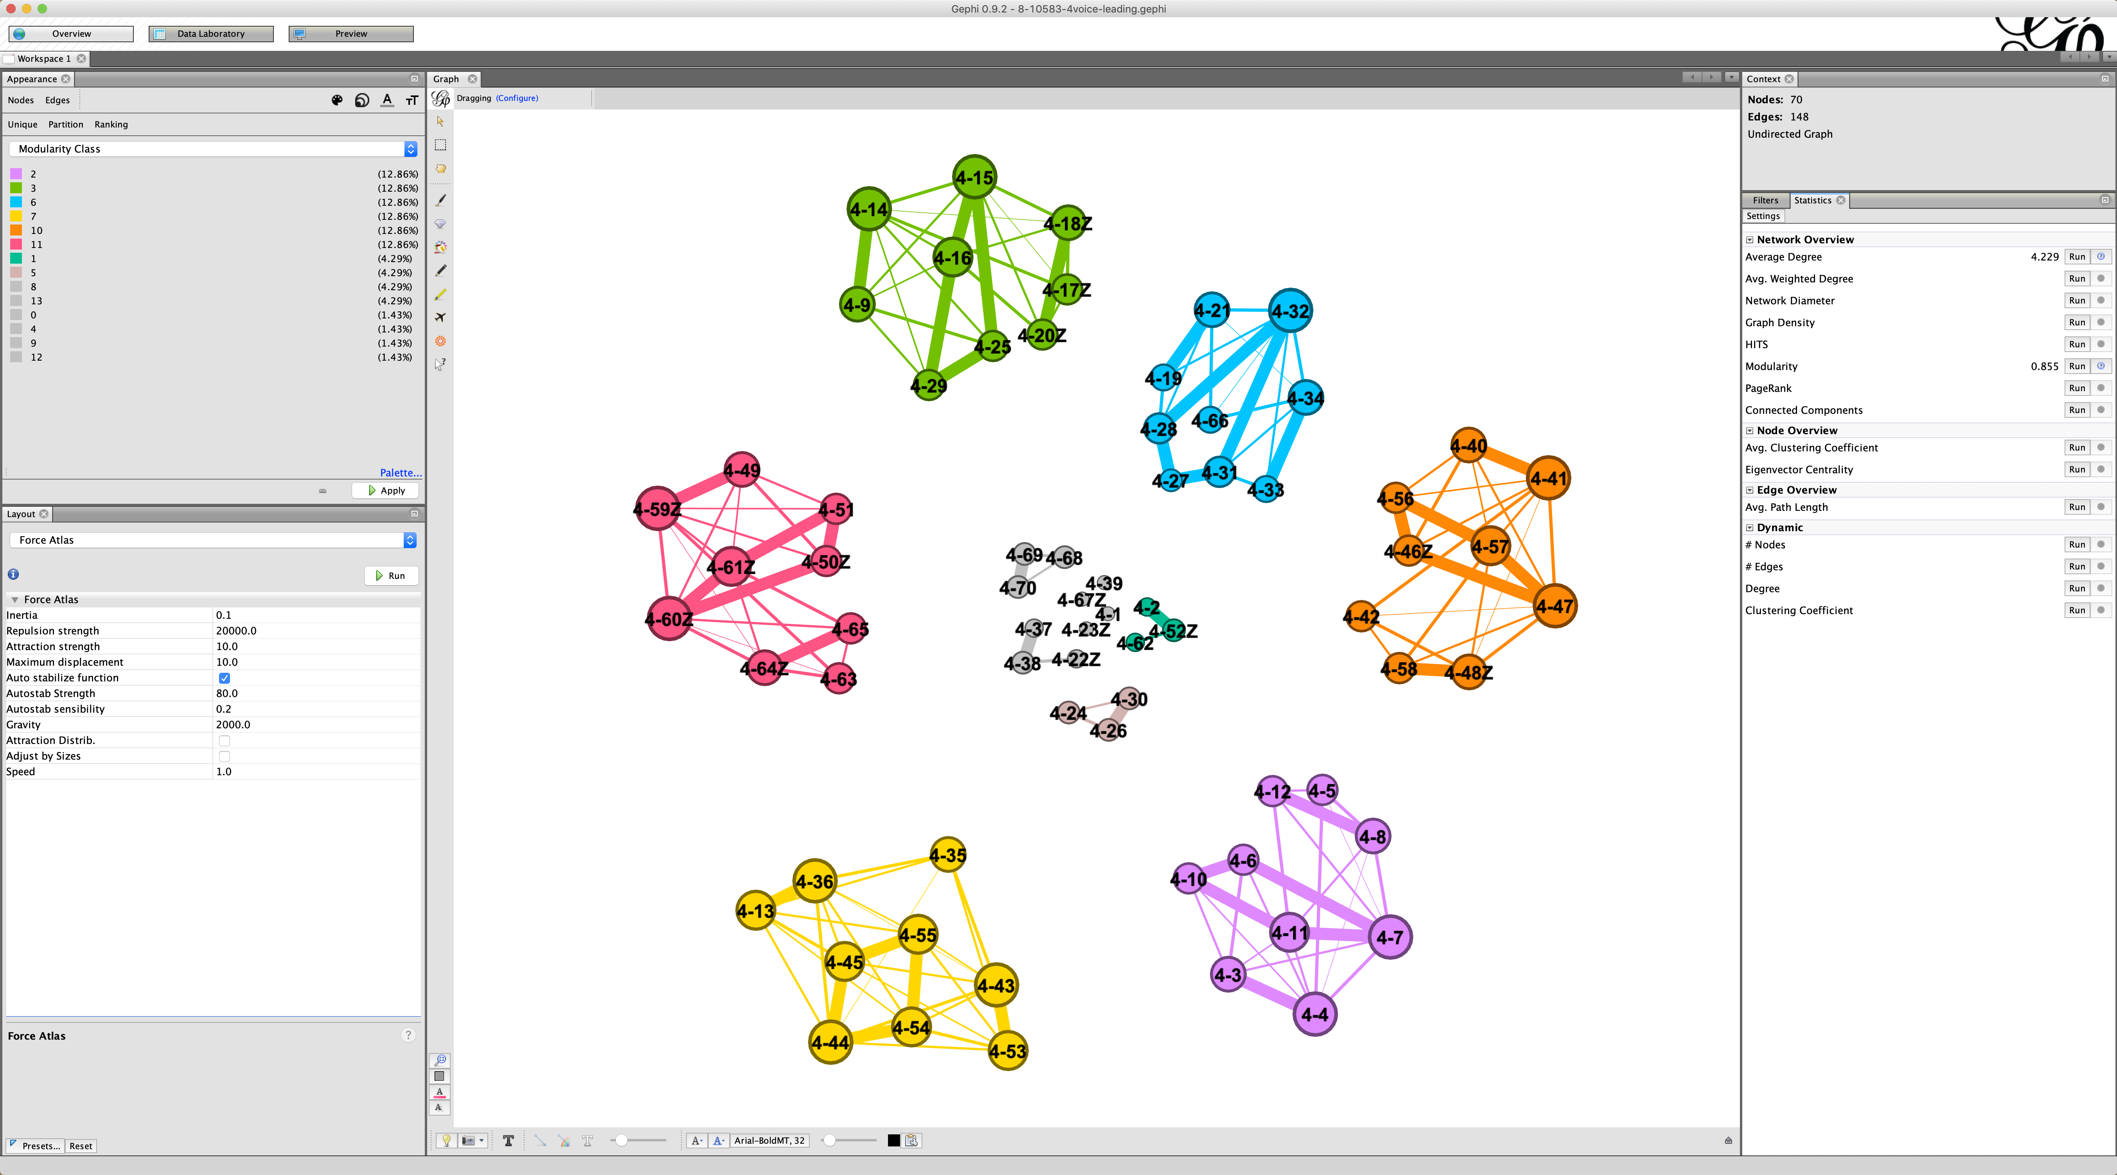
Subspaces of voice leading spaces as compositional frameworks: 8-10583 in 24TET
Gephi: a real-time interactive workspace – 4 voices

Slide 26
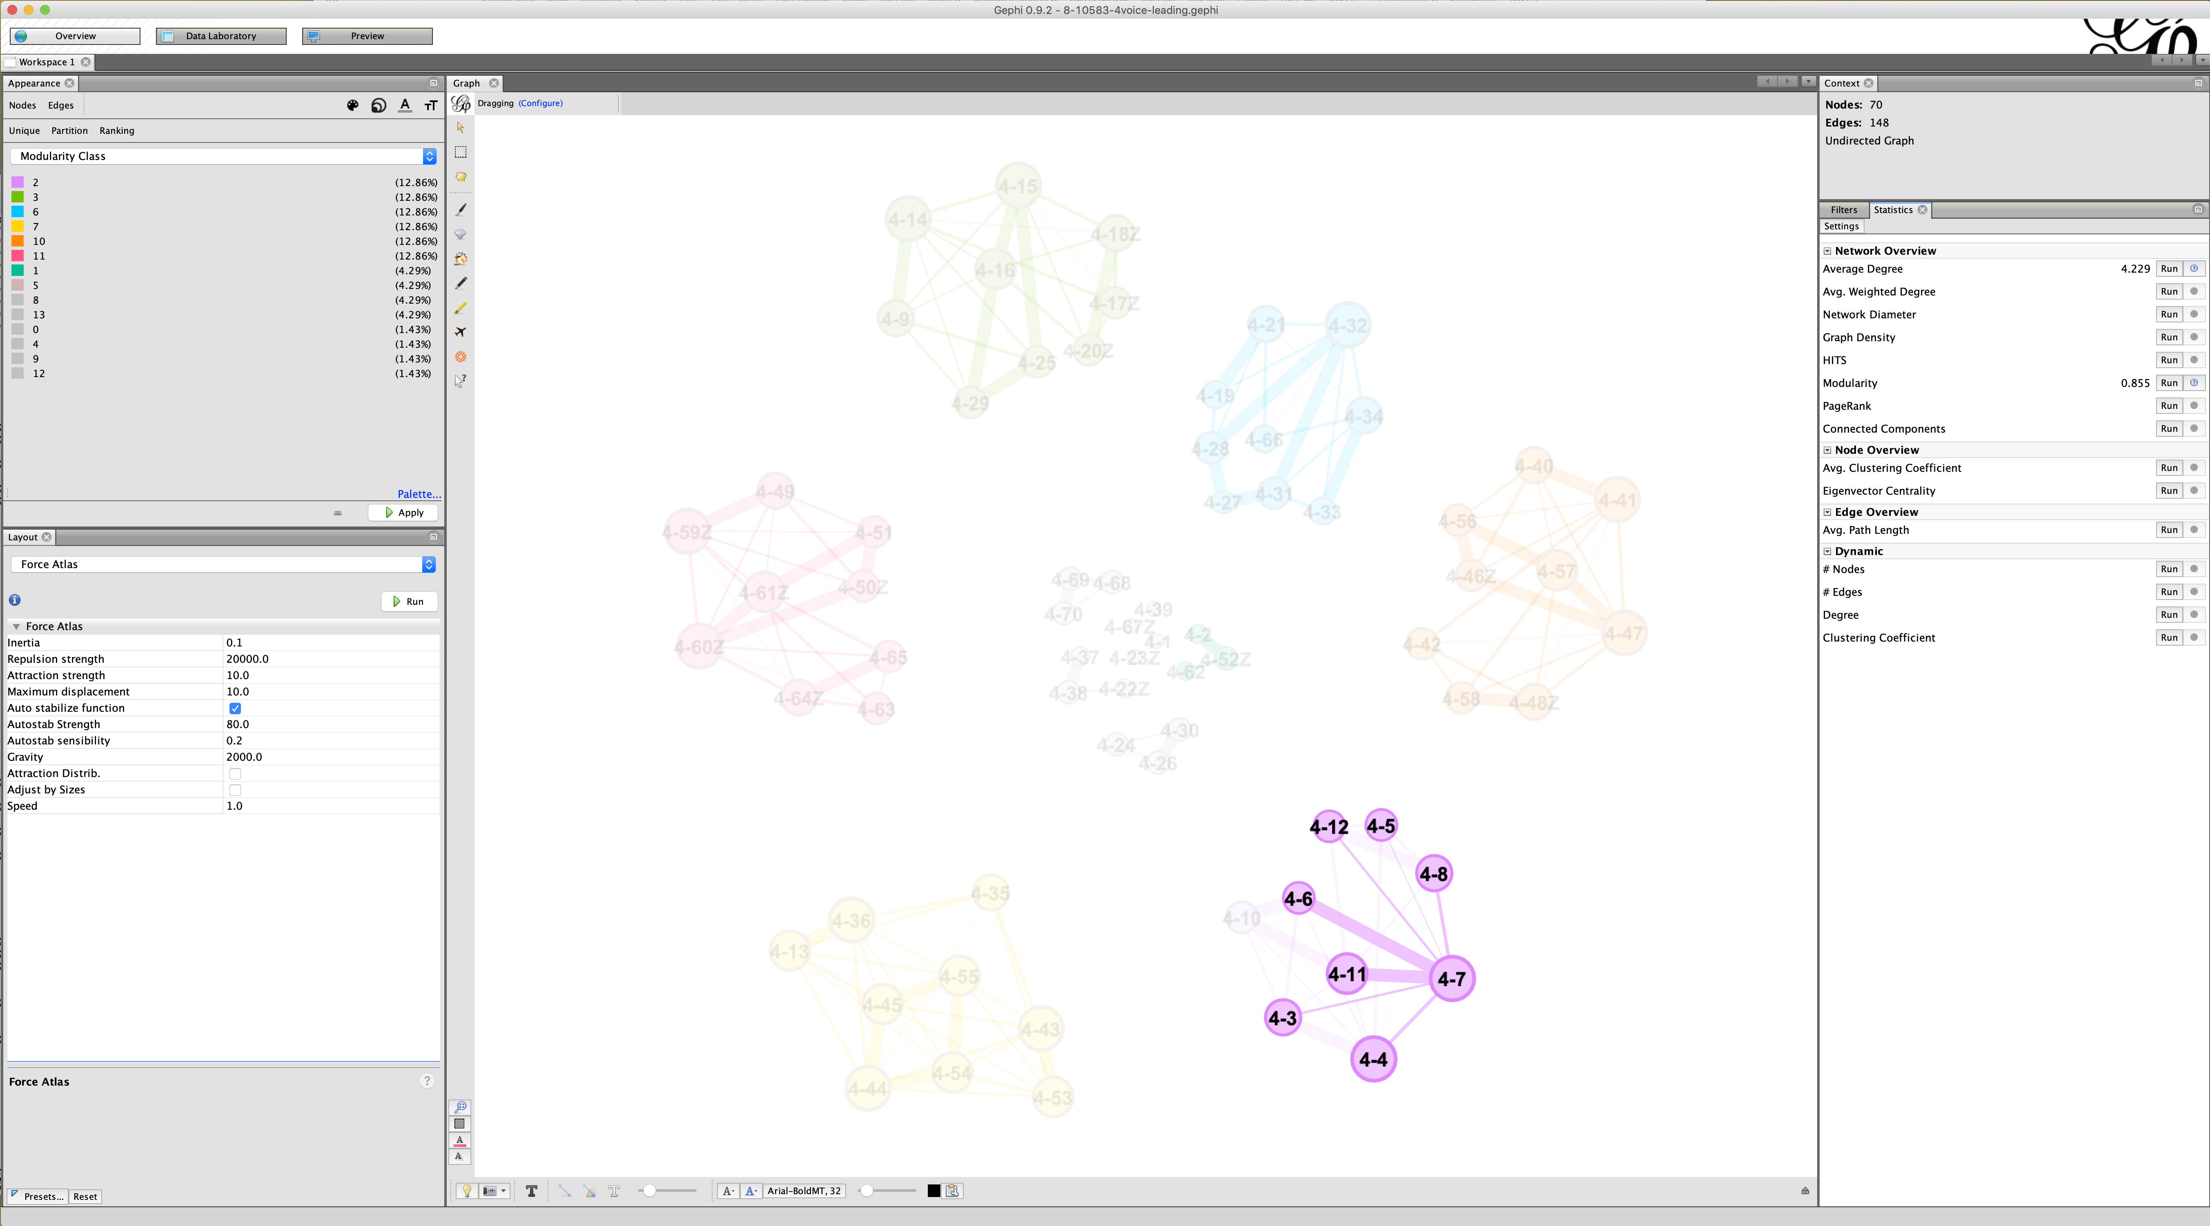
Subspaces of voice leading spaces as compositional frameworks: 8-10583 in 24TET
Gephi: a real-time interactive workspace – 4 voices
all possible
chord
progressions!

